Slide 1
World Cup Analysis Project
Shorouk Ahmed

Slide 2
Outline
Data Collection and Preparation
Data Visualization
Insights
Conclusions

Slide 3
Data Collection and Preparation
1
Missing Values
We have to try to fill the null values or drop it .
2
Duplicated Values
Function to find duplicate values in a pandas DataFrame .
3
Data Cleaning
This includes making sure the data is of the correct type, removing inconsistencies, and normalizing values.

Slide 4
Data Visualization
60%
40%
Player
Team
I’m seek to visualize the relation between player and team also I'm trying to evaluate preformance.
I’m trying to visualize the Data to evaluate team preformance and impact player on team.

Slide 5
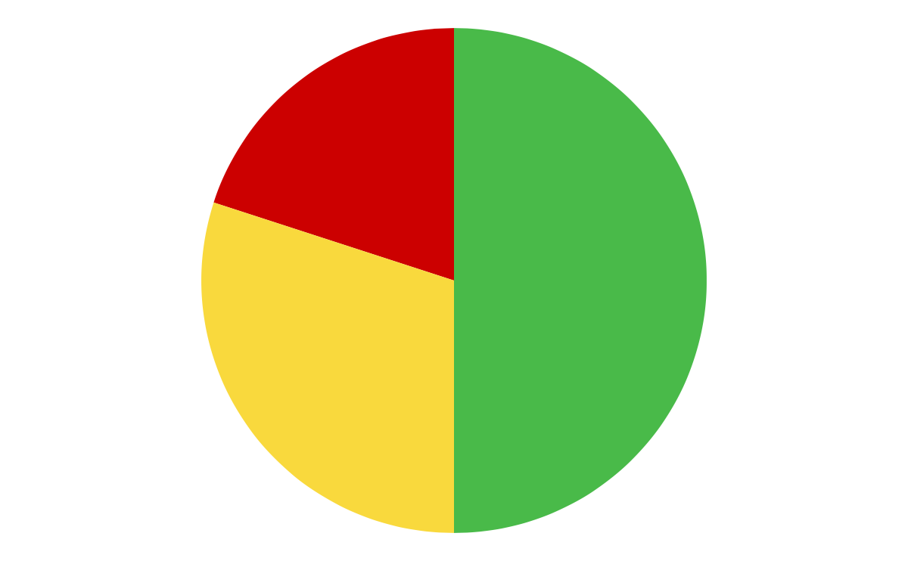
Visualizations
Team
20%
Player
50%
30%
Ground
Visualizations were created using Matplotlib to illustrate trends and patterns in the data. Examples include bar charts depicting total wins by each team, Average Runs per Match for Each Team, Maximum wickets.

Slide 6
Insights
We want to know the impact player on his team
We got know the most runs scored
17%
30%
30%
23%
We want to know the top player and his country
We got know the most wickets scored

Slide 7
Conclucion
Player
The exploratory data analysis provides valuable insights into the Cricket World Cup data from 1975 to 2019. The project successfully imported and transformed the data
45%
Team
and visualized trends through various charts. The findings contribute to a better understanding of the tournament’s history and the performance of participating teams.
55%

